Slide 1
Lab presentation - SingleCellViz, a R Shiny App
Valentine Gilbart
17/05/2024
Notes:
Hello everybody, for today’s lab meeting I will present you a development that I did to easily visualize the lab’s scRNA-seq dataset.

Slide 2



Current use of scRNA-seq datasets at the lab
More than 30 scRNA-seq samples generated from the lab
Are they used up to their potential?
cleaned object with validated annotation
basic exploration without coding
easily accessible to all
→ Create lab’s scRNA-seq library accessible online
Notes:
Indeed, internally we have more than 30 scRNA-seq samples
But how often do you really take the time to explore them? share them with other member of the team? are their really used up to their full potential?
That’s why we thought of creating a sort of online accessible library
Intern scRNA seq not currently (re)used bc we don’t all code
Avoir la main
On a validated object
Dynamique pour consulter les objets
Visibility of the team

Slide 3



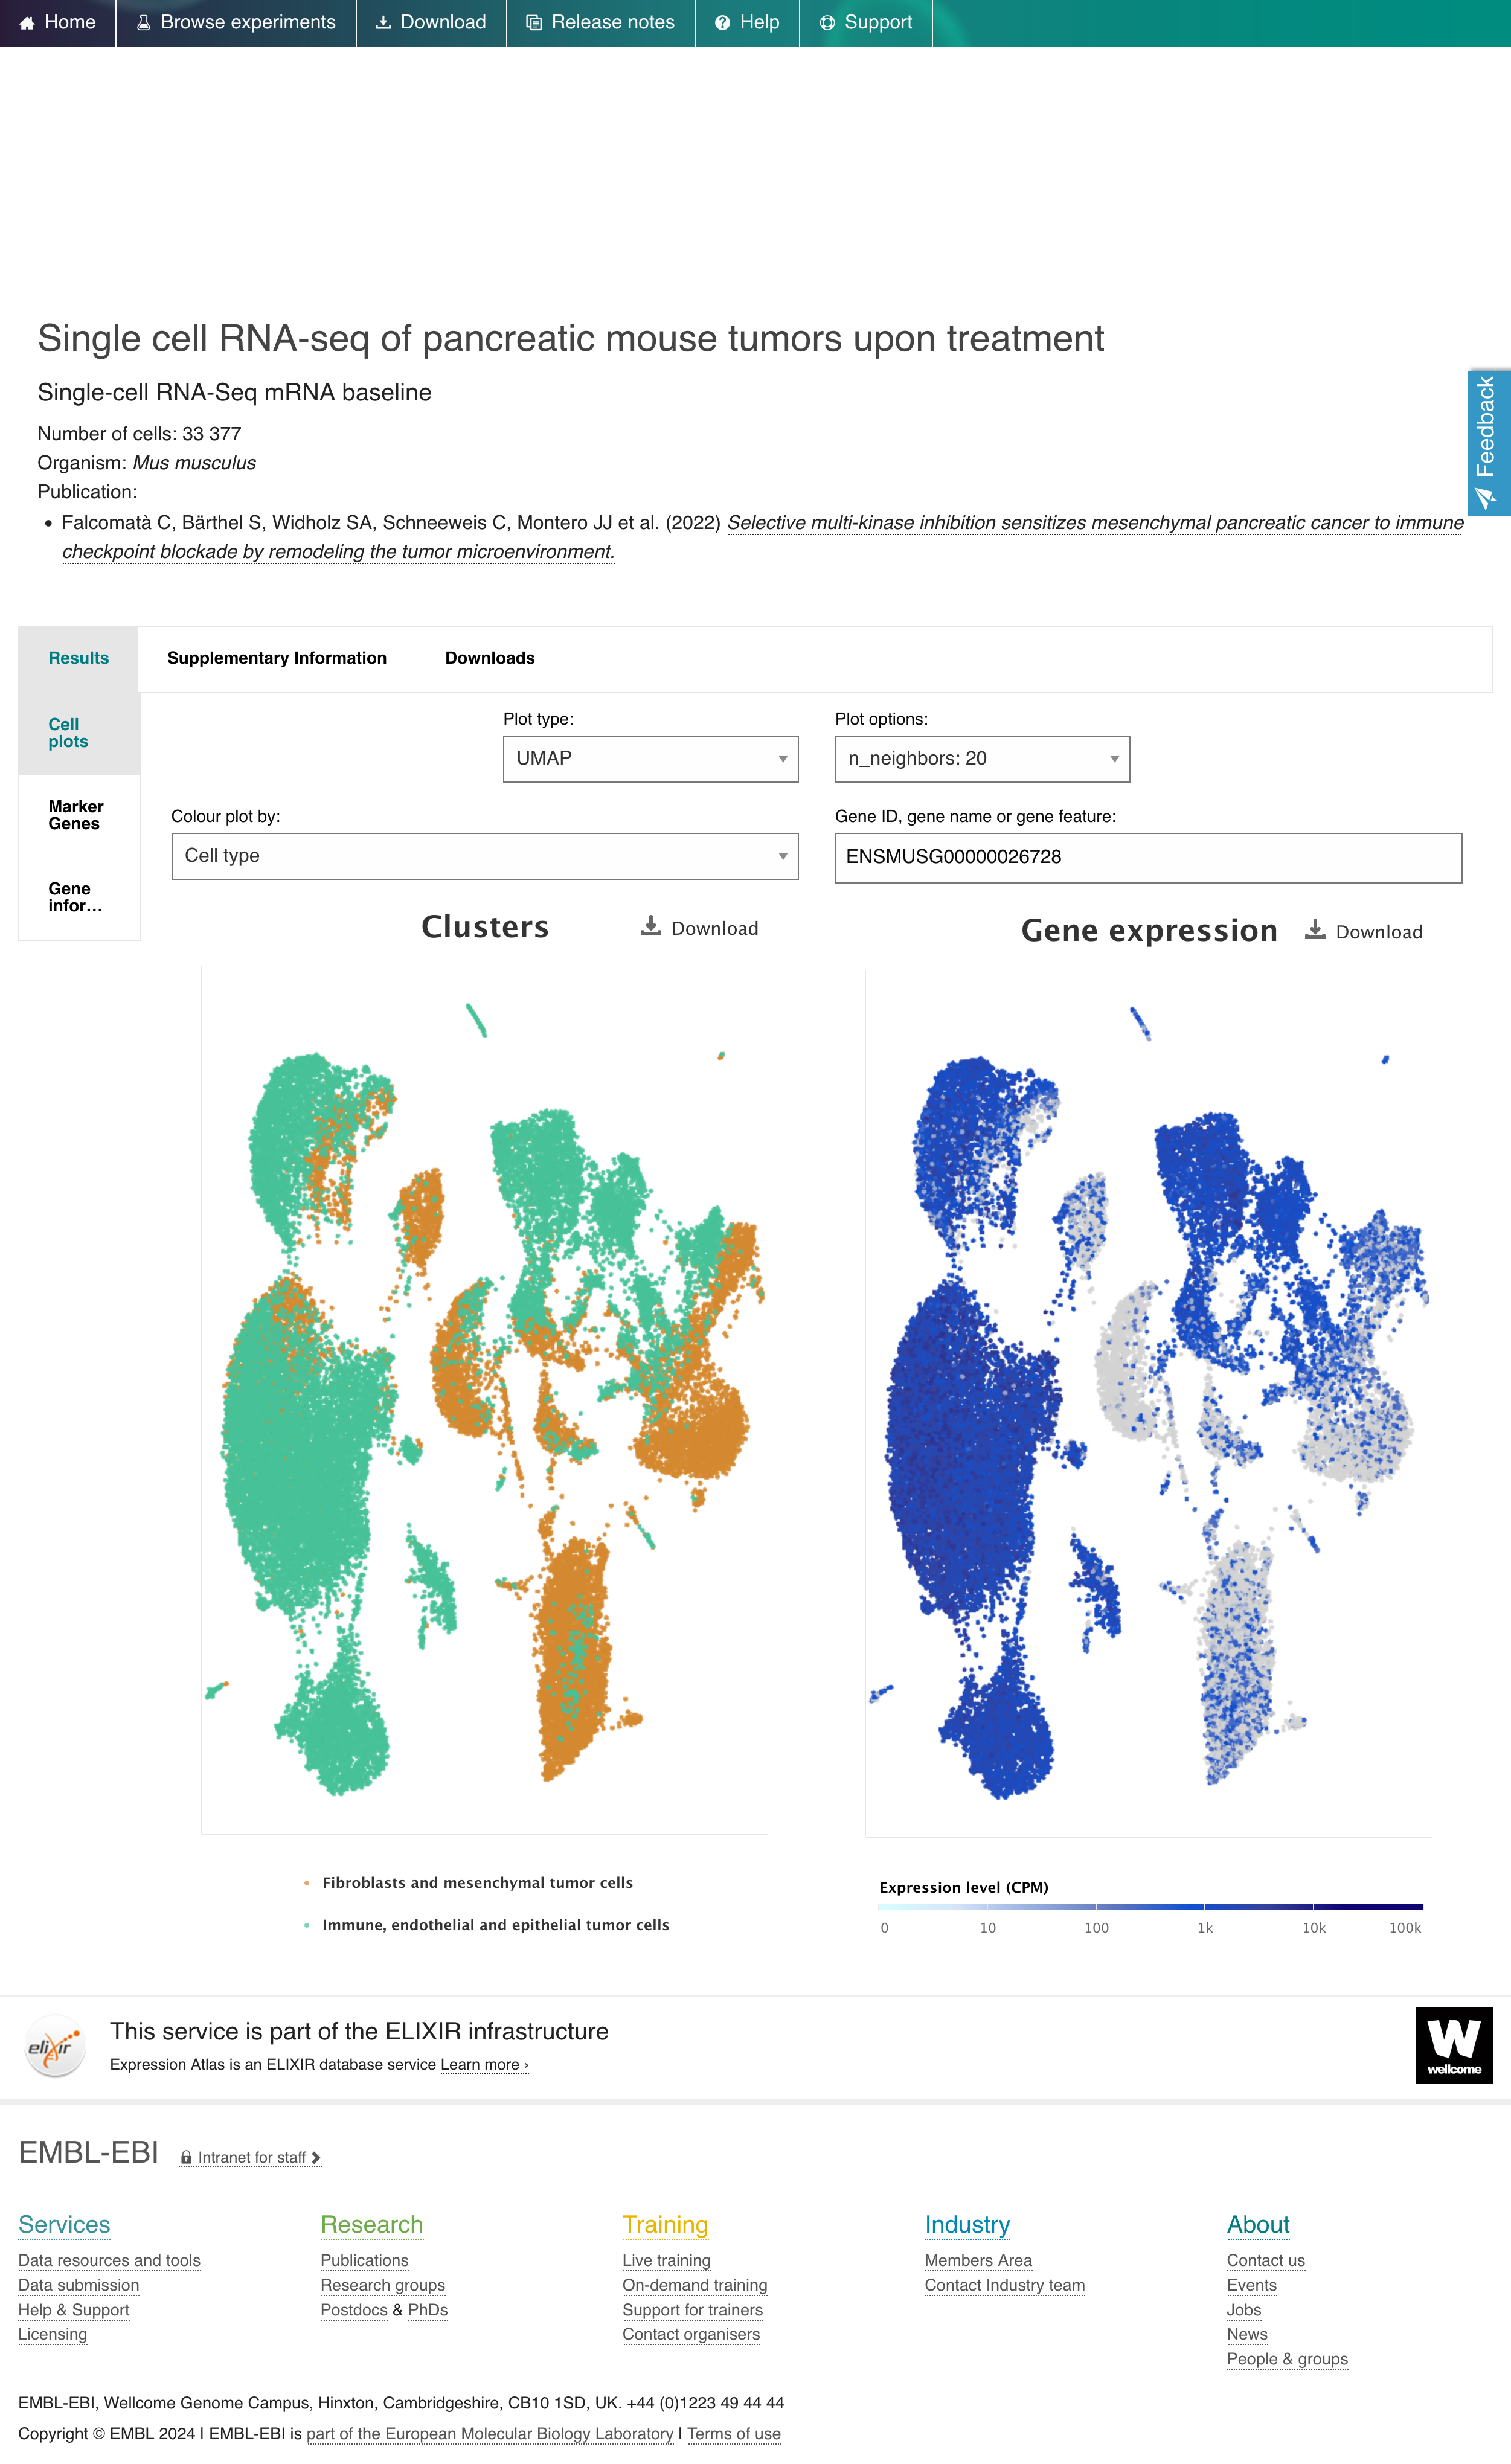
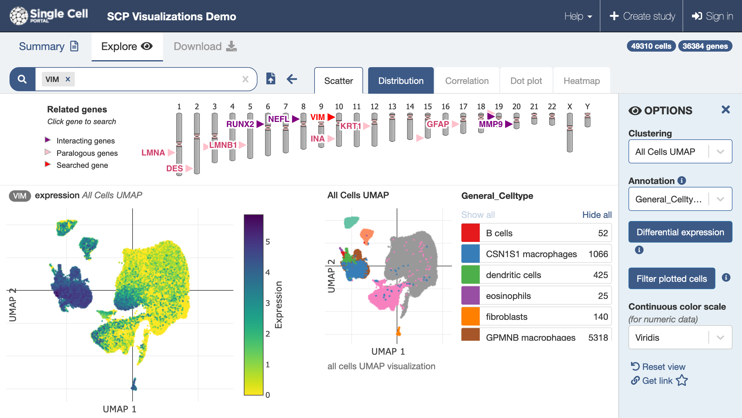
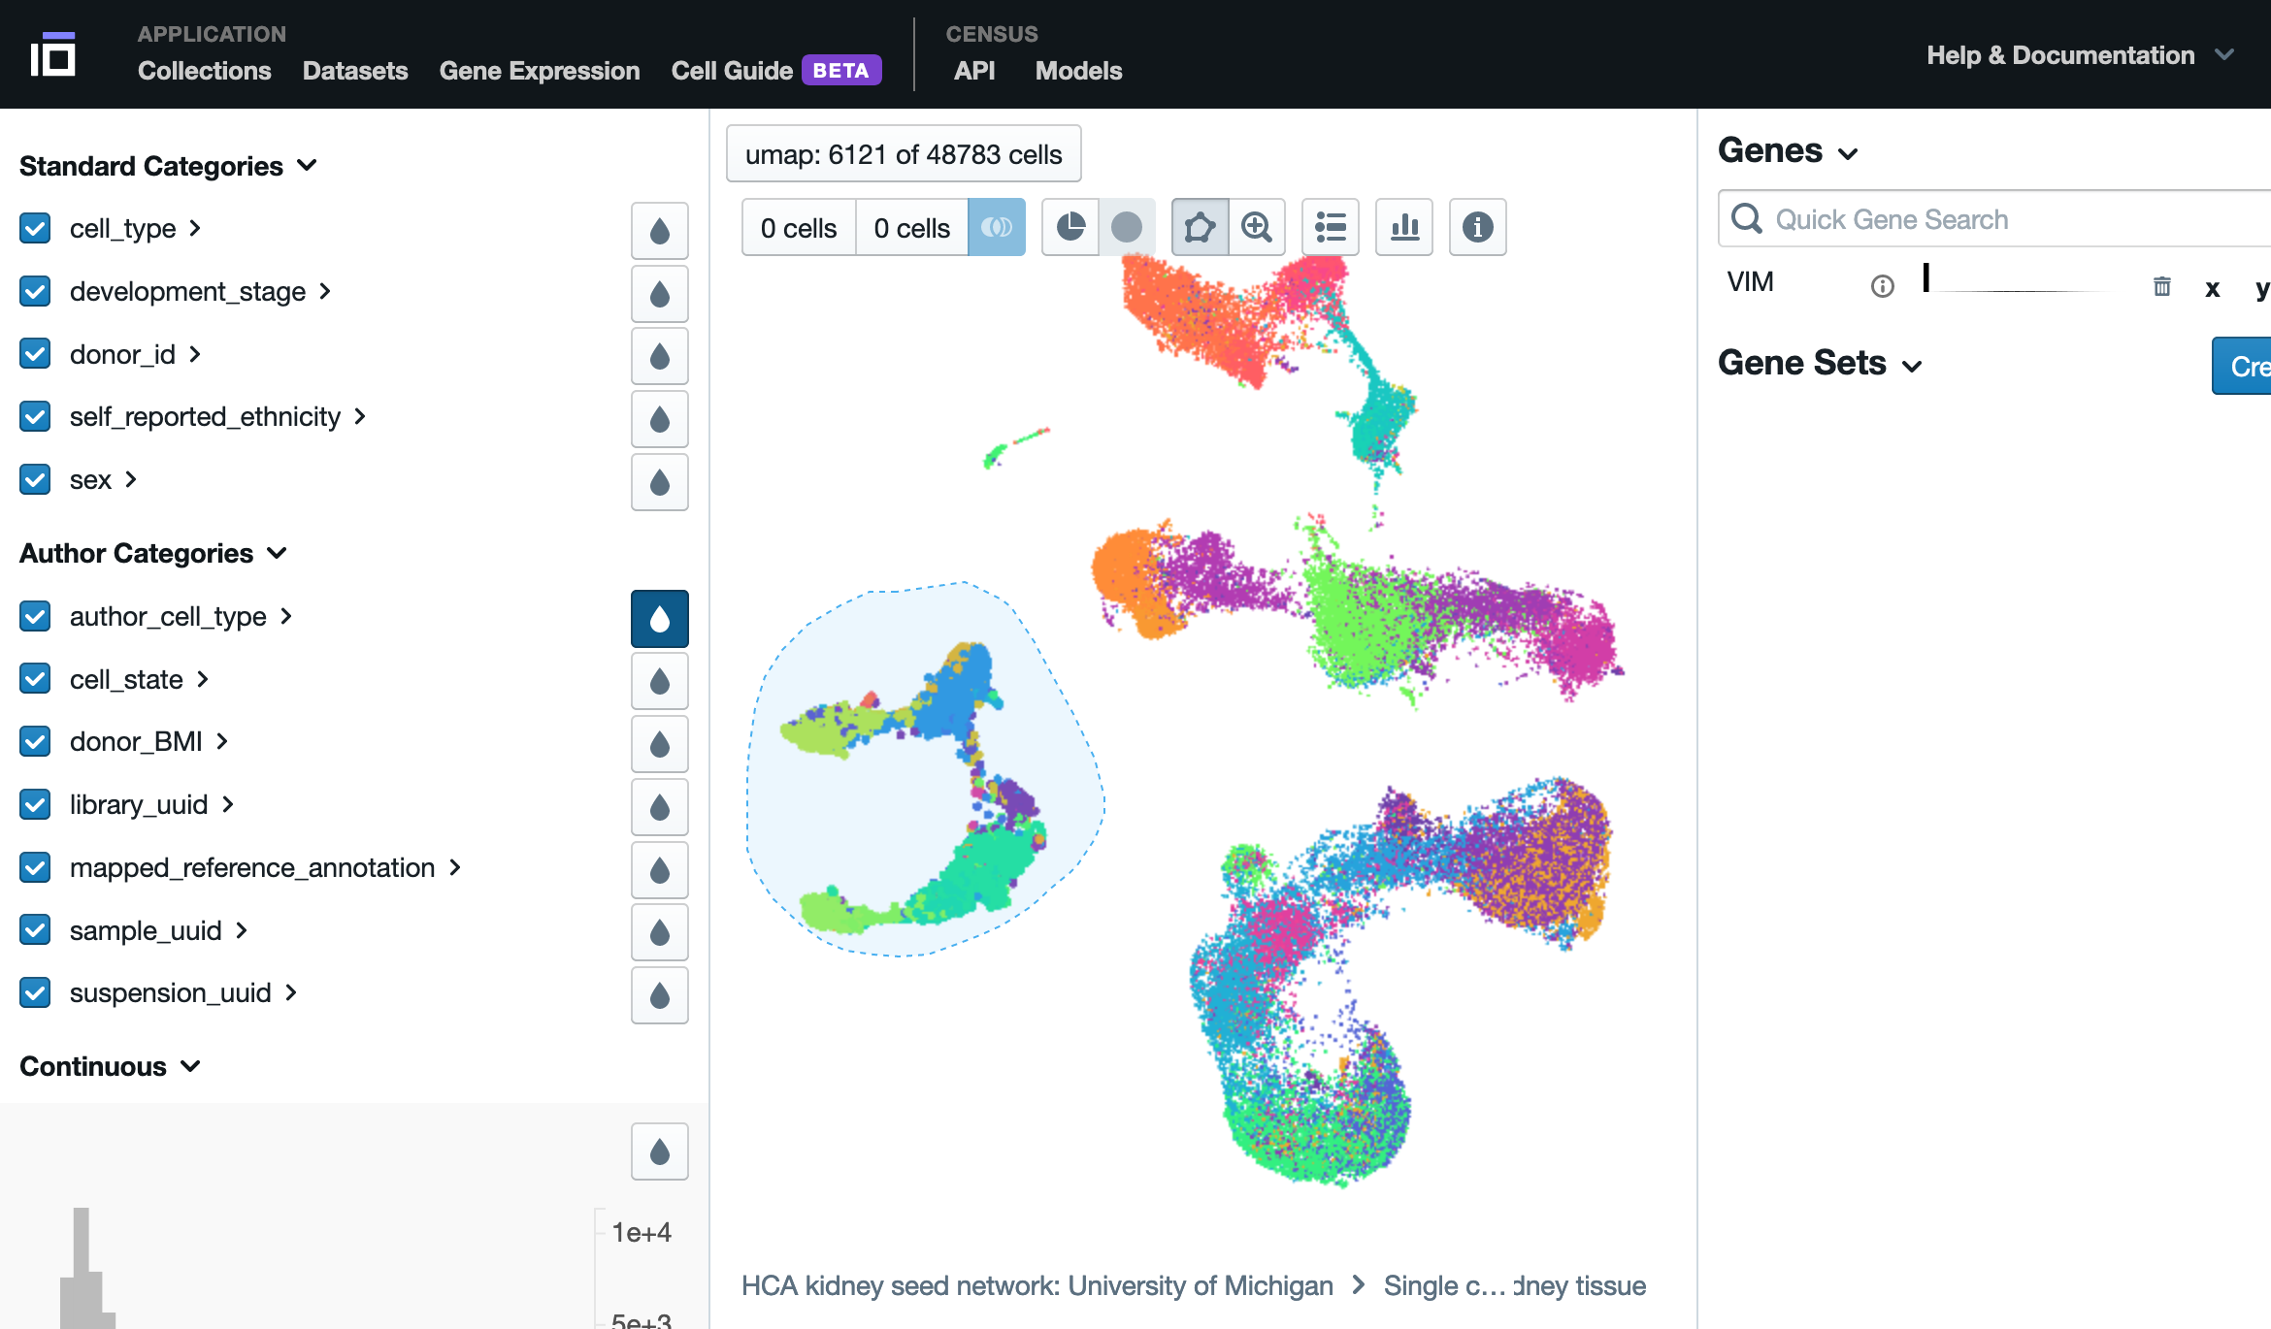
Online single cell visualizer/explorer
https://www.ebi.ac.uk/gxa/sc/home
https://cellxgene.cziscience.com/
https://singlecell.broadinstitute.org/single_cell
All data are re-analysed using their methods
→ won’t be the exact same results as the published study
Account (google) dependent to download and upload data
Discuss with them whether or not they accept the data
Explorer with super nice features, but:
we don’t have the full hand on the site
you are not guided through the results of the study
we wanted to highlight the lab’s studies

Slide 4

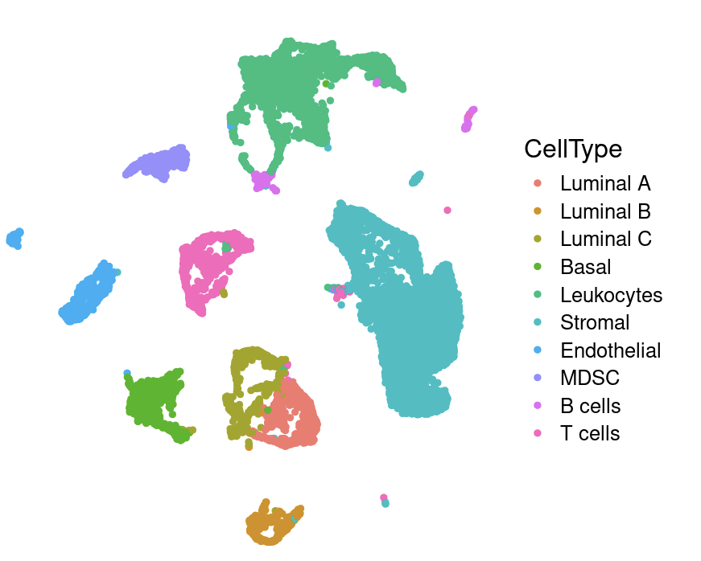
Aim of the app
Create a web application to quickly and dynamically:
Visualize
Explore
Highlight
Download
the results of the lab’s scRNA-seq datasets
Maximize the use of already available dataset
Easily accessible for all
Visibility/showcase of the lab’s studies
NOT MEANT TO:
Perform new analysis

Slide 5

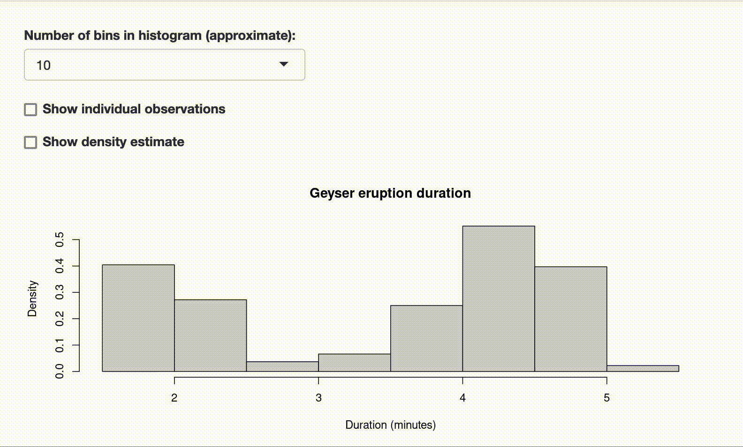
What is Rshiny?
Example of web app
It is usually separated into two files:
- ui.R: user interface, i.e. the look of the app
- server.R: server logic, i.e. the behaviour of the app
They are dependent of one another, as the input of the user (defined in the ui) must have consequences on the output (handled in the server)
R package providing framework for building interactive web applications
Example of ui.R file
Example of server.R file
bootstrapPage(
selectInput(inputId = "n_breaks",
label = "Number of bins in histogram (approximate):",
choices = c(10, 20, 35, 50),
selected = 20),
…
plotOutput(outputId = "main_plot", height = "300px"),
)
function(input, output) {
output$main_plot <- renderPlot({
hist(faithful$eruptions,
probability = TRUE,
breaks = as.numeric(input$n_breaks),
xlab = "Duration (minutes)",
main = "Geyser eruption duration")
…
})
}
The app can be:
- run on local device
- deployed to the cloud (Shinyapps.io)
- deployed to a server (Shiny Server)
Notes:
User interface : layout, design, and elements that users interact with, such as buttons, text inputs, plots
Server : processes user inputs, performs calculations, and generates outputs
See the link between the two n_breaks

Slide 6
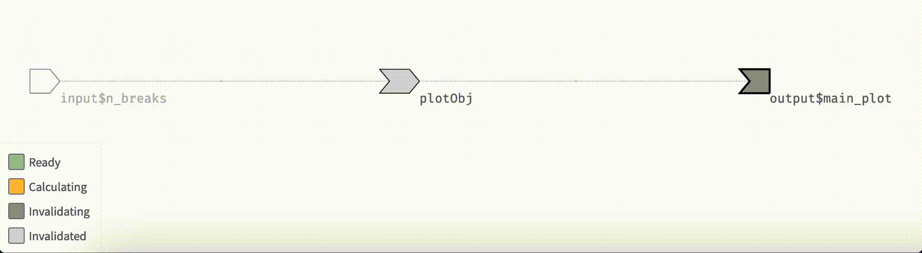
How does Shiny work?
Example of reactivity log when to output a plot with a change of input
Example of ui.R file
Initialization of the page: output$main_plot needs to be calculated
Everything is “ready”
Change in input$n_breaks: every object that depends on it gets invalidated
Recalculation of output$main_plot
Everything is “ready” again
→ This is what happens to every reactive element of the app
Example of server.R file
bootstrapPage(
selectInput(inputId = "n_breaks",
label = "Number of bins in histogram (approximate):",
choices = c(10, 20, 35, 50),
selected = 20),
…
plotOutput(outputId = "main_plot", height = "300px"),
)
function(input, output) {
output$main_plot <- renderPlot({
hist(faithful$eruptions,
probability = TRUE,
breaks = as.numeric(input$n_breaks),
xlab = "Duration (minutes)",
main = "Geyser eruption duration")
…
})
}

Slide 7
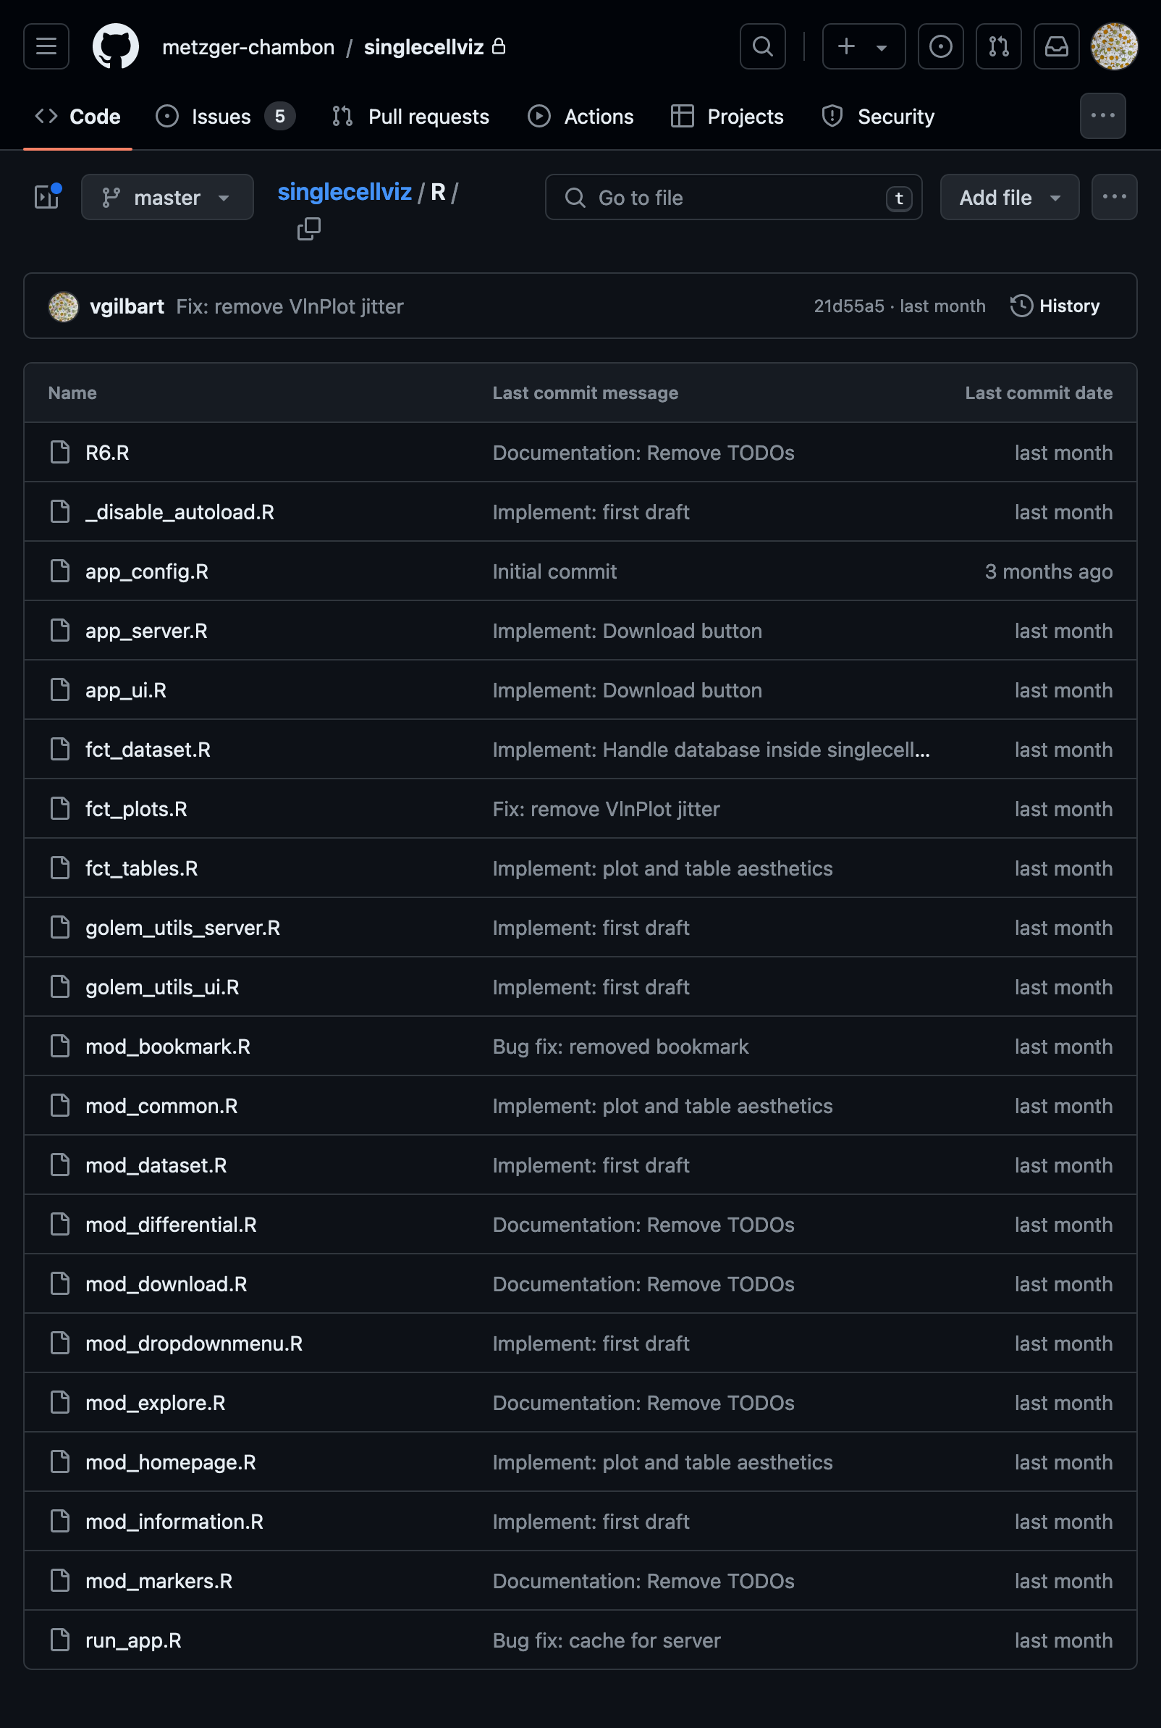
Structure of the App
Server and ui files
Common functions to handle dataset/plots/tables
Shiny modules (~independent parts of the app, e.g. each tab has its module)
Modules are called in the app_server.R and app_ui.R
Important R files of the app

Slide 8
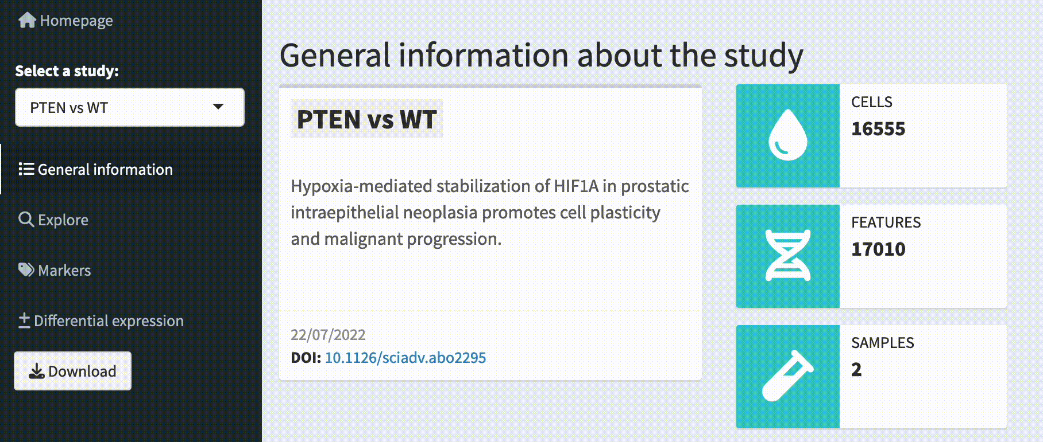
General information tab
Screen recording of the app
The study is saved in a reactive object called r$selected_study, when it changes, it recalculates elements of the page (e.g. text in this example)
Example of server module
mod_information_server <- function(id, COMMON_DATA, r) {
moduleServer(id, function(input, output, session) {
output$study_title <- renderText({
studies[r$selected_study,, drop = F]$title
})
…
output$ncells <- renderInfoBox({
ncells <- studies[r$selected_study,, drop = F]$ncells
infoBox(
"Cells",
ncells,
icon = icon("droplet"),
color = "teal"
)
})
})
}
Example of ui module
mod_information_ui <- function(id) {
ns <- NS(id)
fluidRow(
box(
title = textOutput(ns("study_title")) %>% tagAppendAttributes(class = 'study-title’)
…
),
div(
infoBoxOutput(ns("ncells")),
…
)
)
}

Slide 9
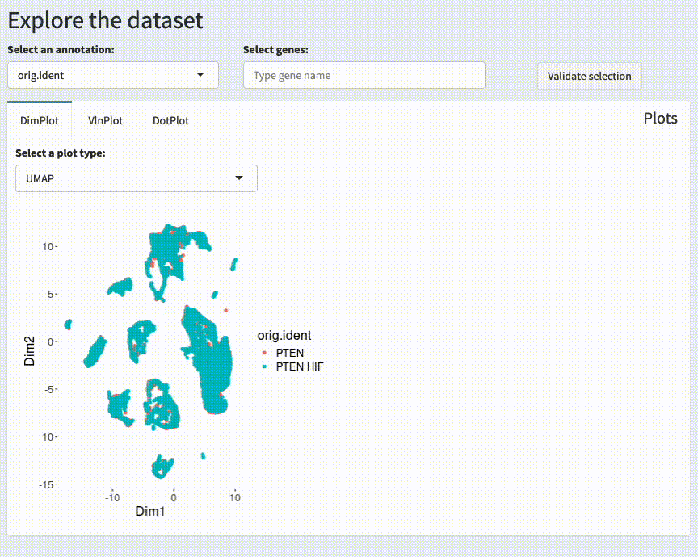
Explore tab - DimPlot
Possible:
plot types
annotation
genes
are dependant on the selected study.
Screen recording of the app

Slide 10
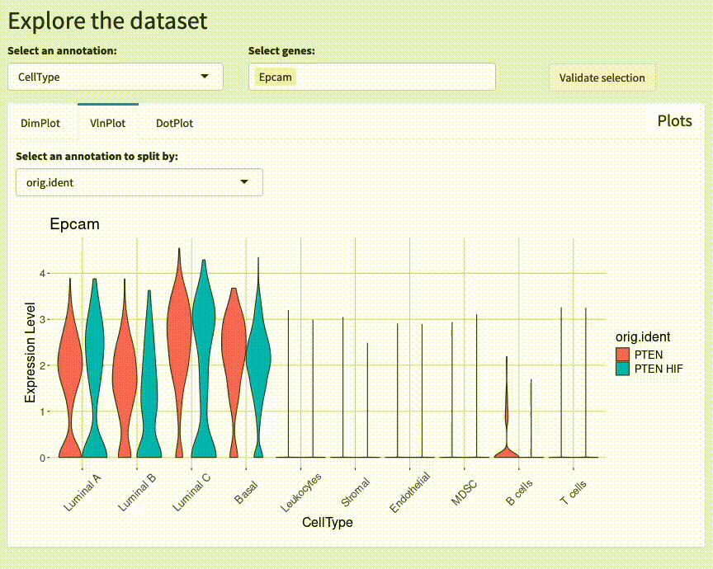
Explore tab - VlnPlot
Possible:
plot types
annotation
genes
are dependant on the selected study.
Screen recording of the app

Slide 11
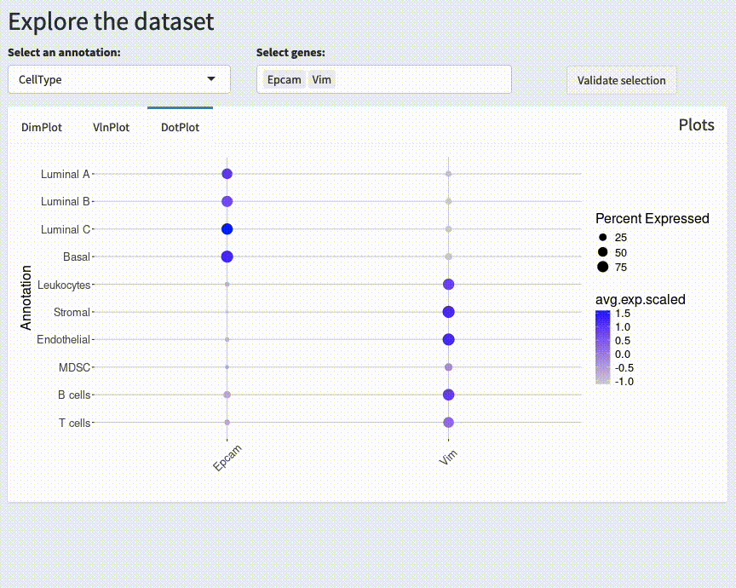
Explore tab - DotPlot
Possible:
plot types
annotation
genes
are dependant on the selected study.
Screen recording of the app

Slide 12
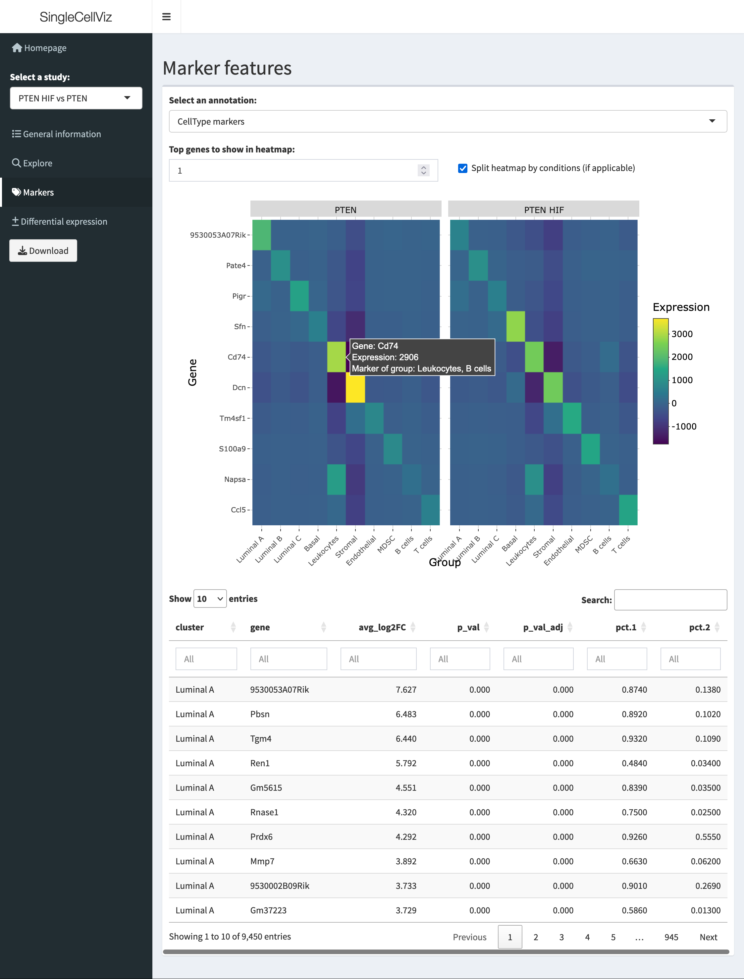
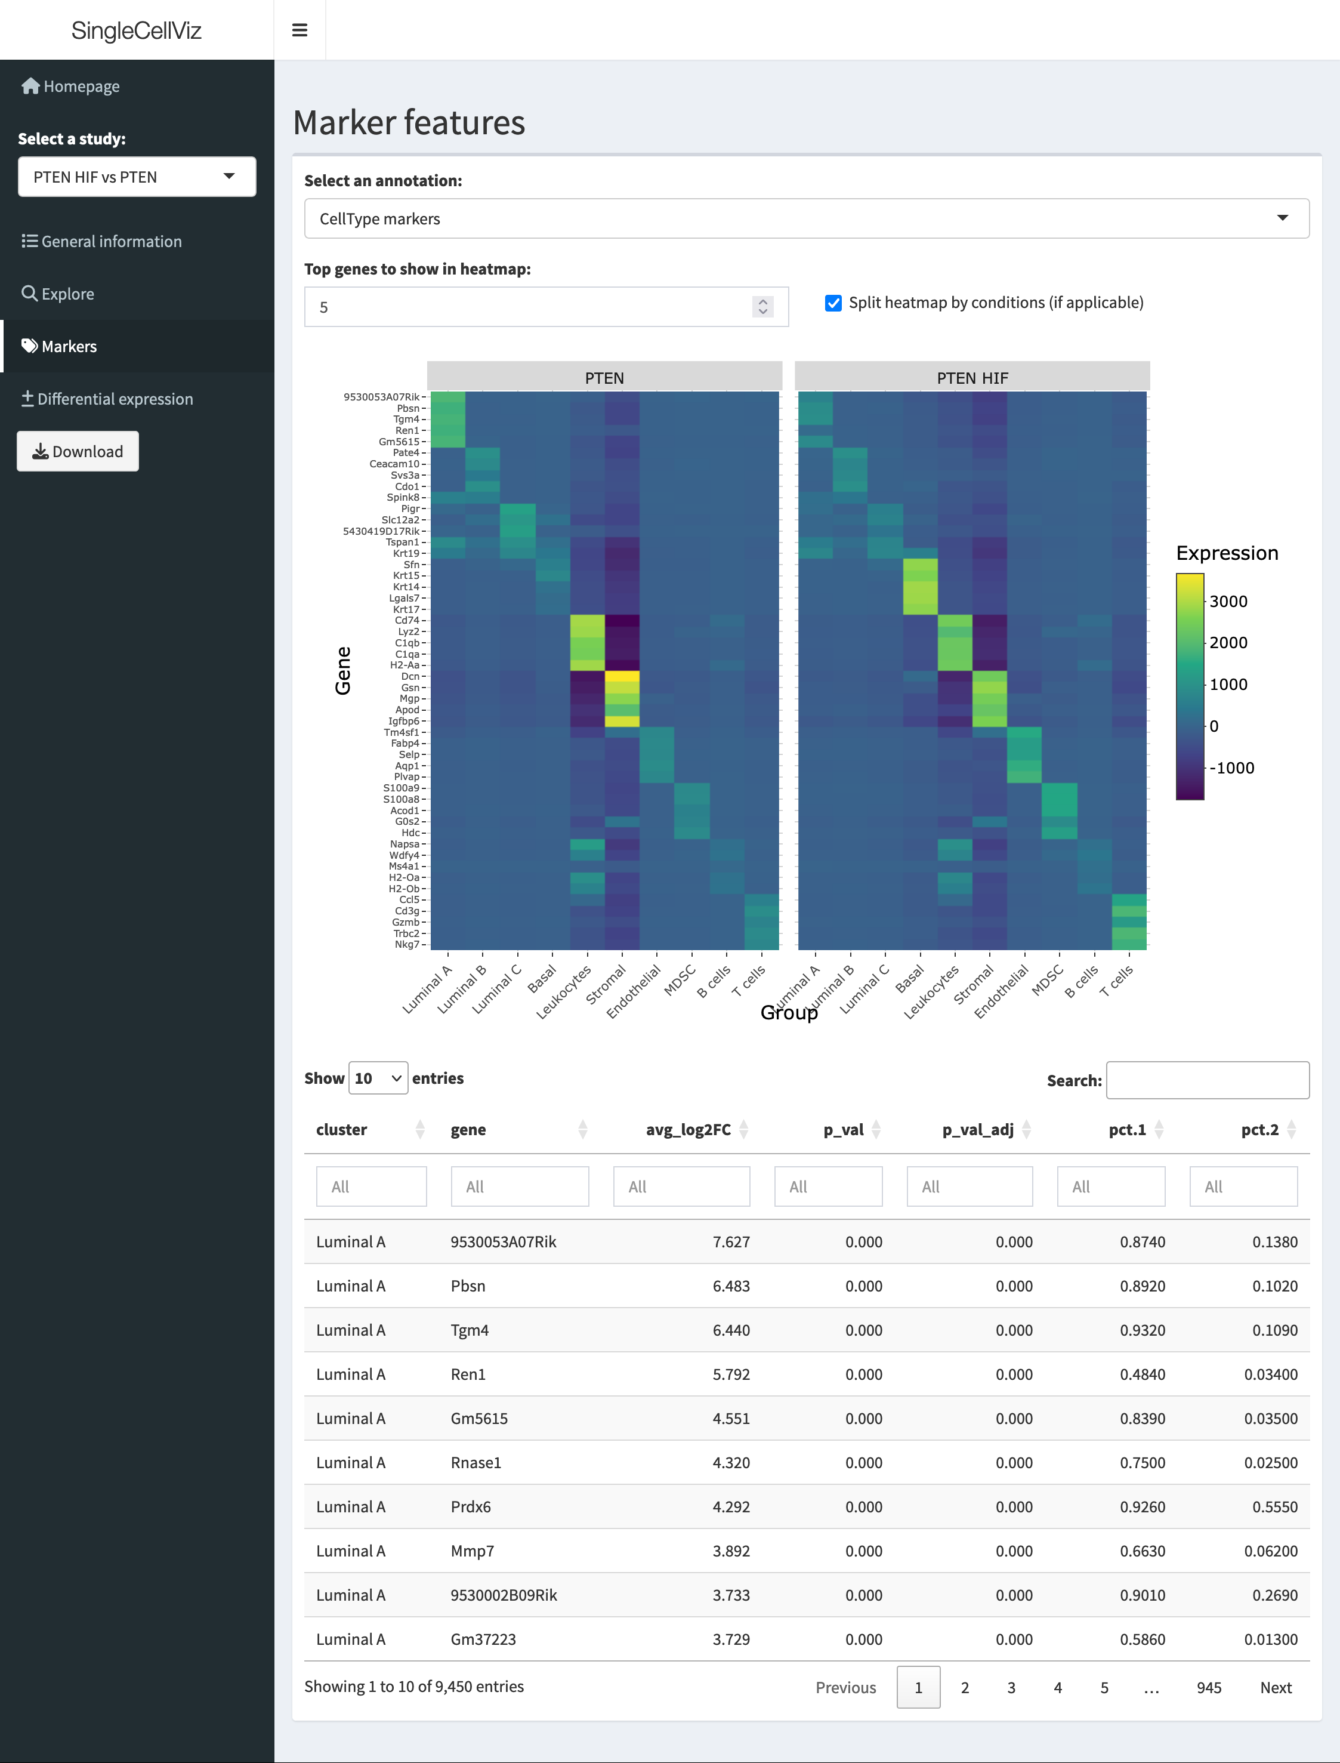
Markers tab
Table result = Seurat’s FindAllMarkers() table
Precalculated and saved in a database (more details later)
Filter based on columns in the table → heatmap updates
Screenshot of the app
Screenshot of the app

Slide 13
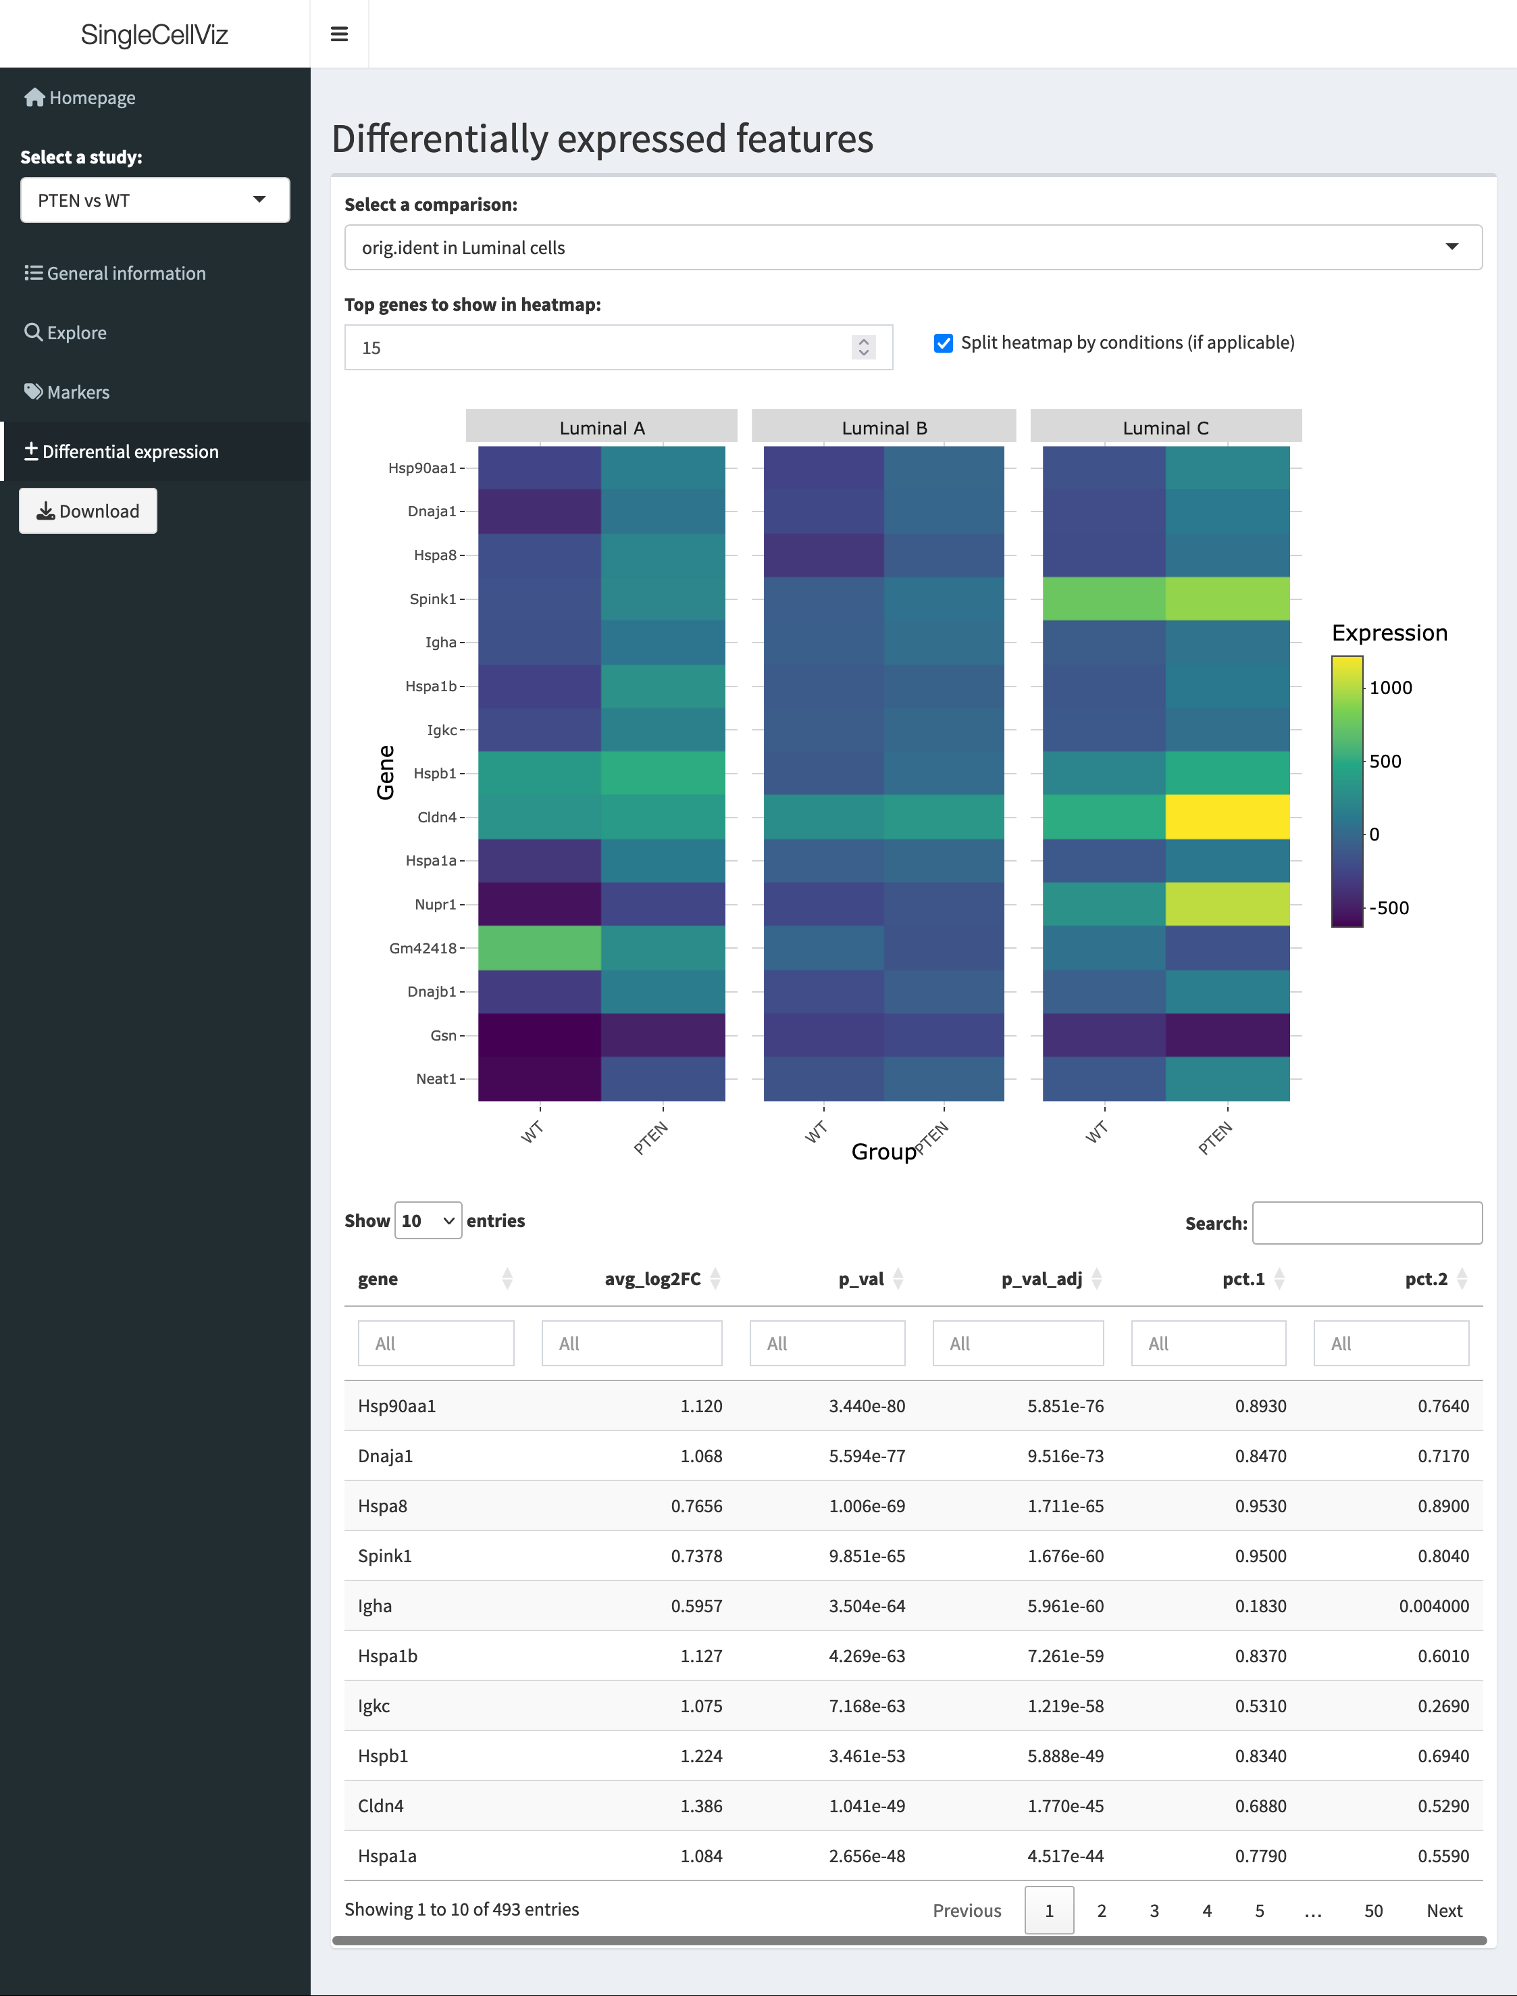
Differential expression tab
Similar to previous tab:
Table result = Seurat’s FindMarkers() table
Precalculated and saved in a database (more details later)
Filter based on columns in the table → heatmap updates
Screenshot of the app

Slide 14
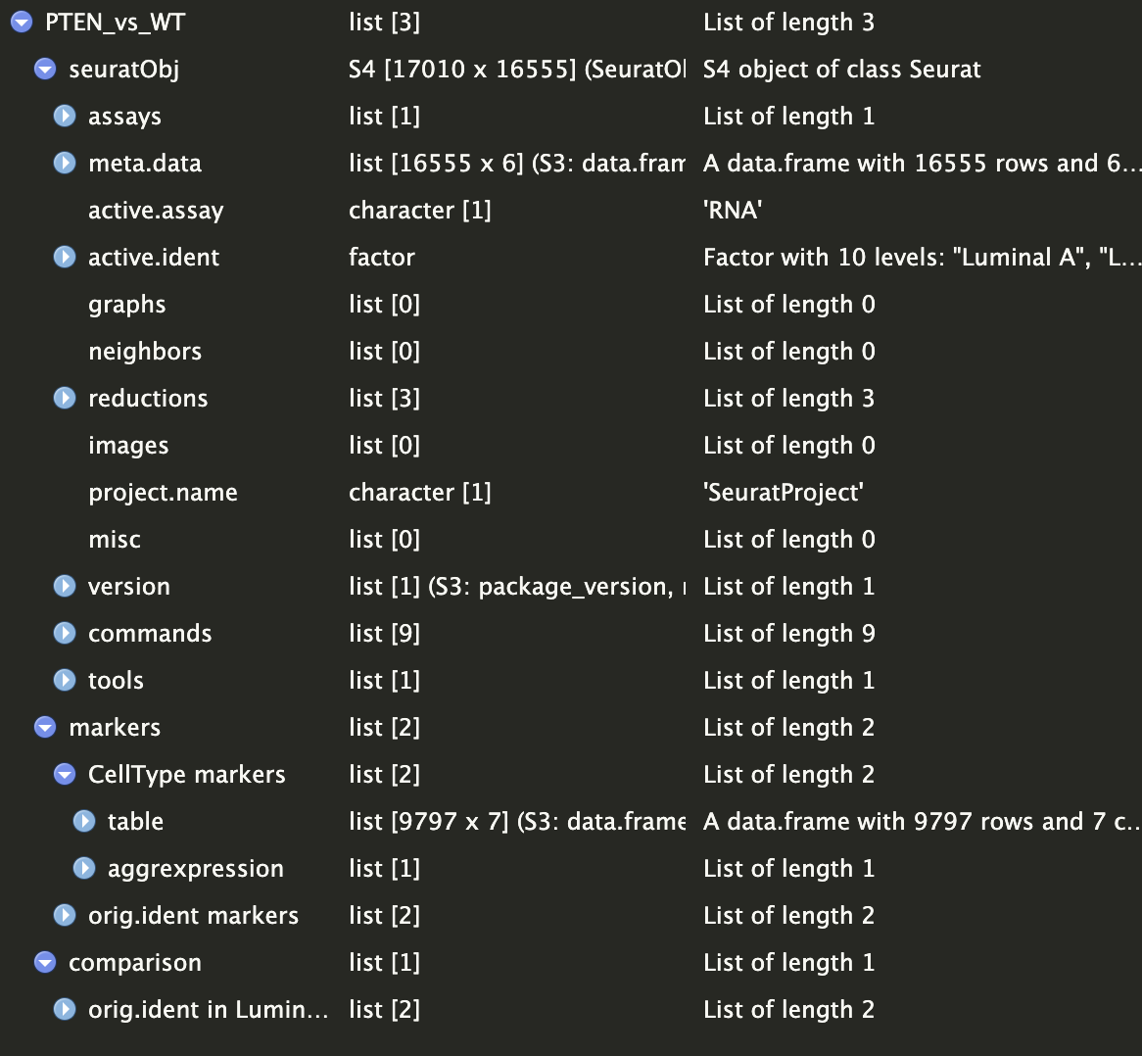
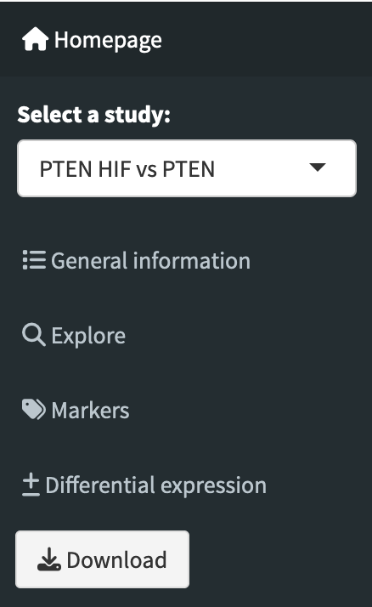
Download a dataset
An R object containing:
Seurat object
Markers table and aggregated expression
Differential expression table and aggregated expression
can be downloaded for further exploration in R.
Content of the downloadable R object
Notes:
Seurat v4 to match the study but, can be update to v5

Slide 15
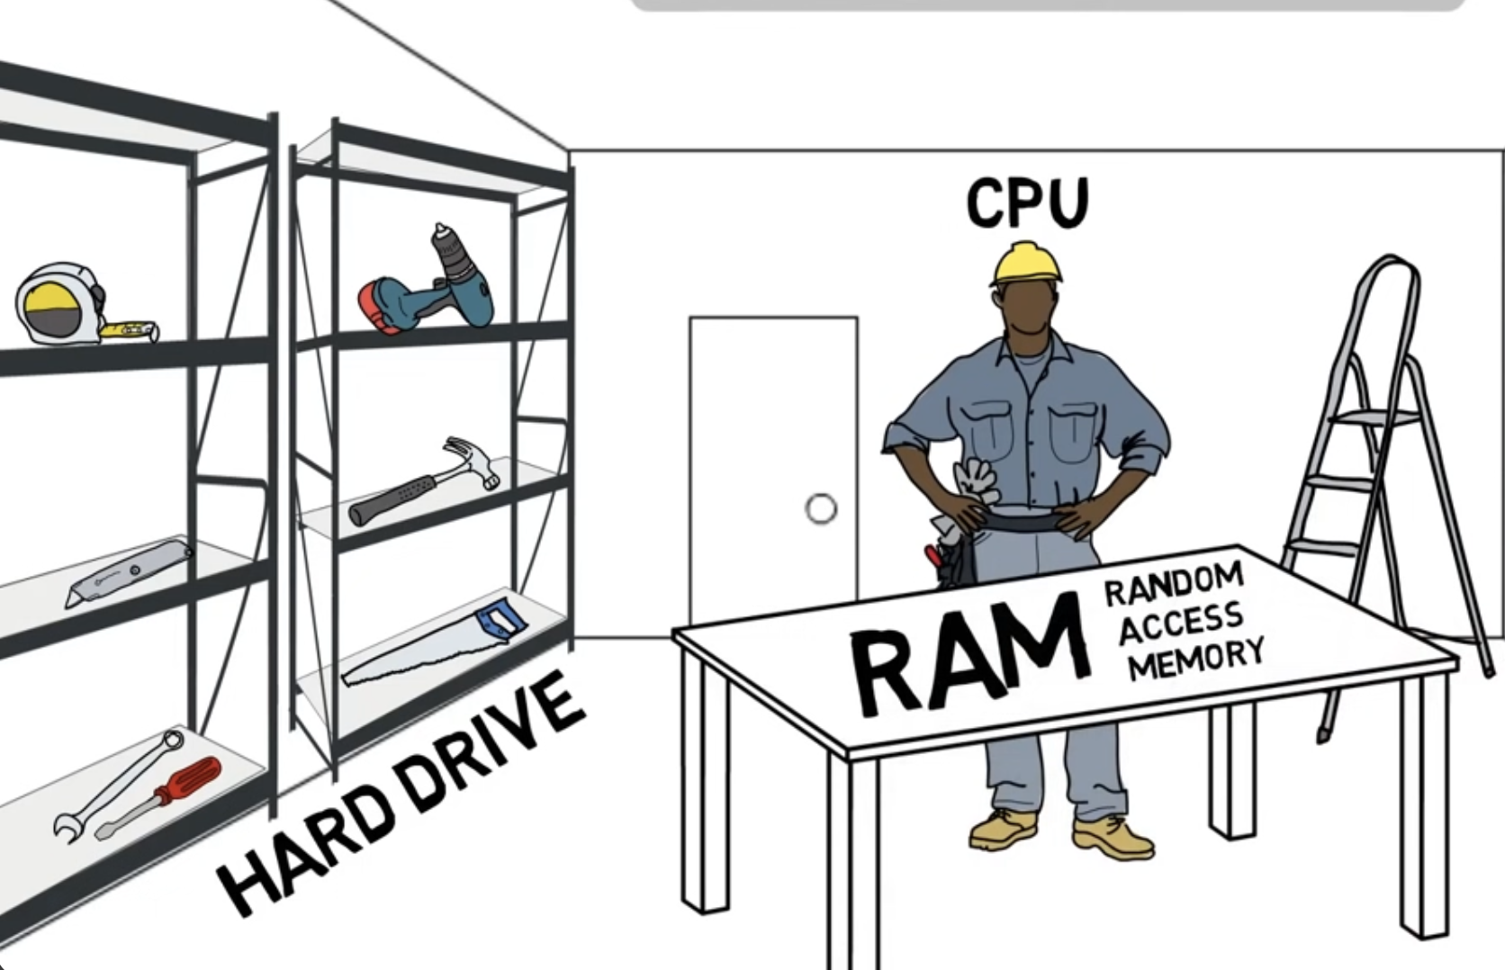
Deployment to a local server
Execute computations
With the help of the IT team, we now have a server with:
8 Go hard disk drive
4 Go RAM
1 vCPU
Admin rights to Gilles and myself
Currently deployed to IGBMC’s internal network + VPN
This also means that we could create other apps, or a static website if we wish ☺
The app is at the address: https://metzger-chambon.igbmc.science/SingleCellViz/
Everything that the app needs to run is on this server: the datasets, the R scripts, the R libraries…
Temporary
storage
(for rapid access)
Long term storage
Analogy of CPU, RAM, hard drive

Slide 16
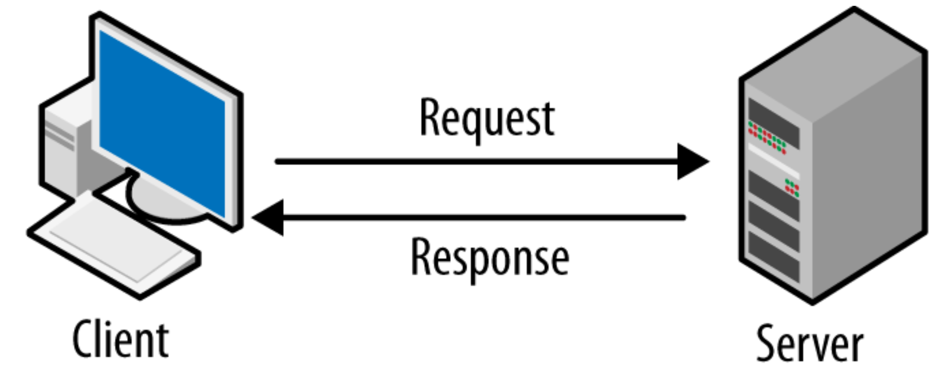


Cache
Requesting a database, and parsing the data takes a couple of seconds…
Some of the data are always needed (e.g. UMAP), or can often be requested (genes of interest).
Use cache to reduce waiting time!
Records output without recomputing, if it had the same keys (input, date)
In practice, it saves a R object and reloads it when needed
Shared across users
Fixed total size (default 200 Mo)
Automatically removes least recently used data if needed

Slide 17


Server limitations
Server’s RAM: 4 Go
No user ~ 600 Mo
Launch Shiny ~ 1 Go
+ Data per user ~ 200 to 400 Mo
Limited to ~ 5 to 10 simultaneous users
Server’s hard disk: 8 Go
app scripts ~ 500 Ko
cache ~ 200 Mo
R libs ~ 1 Go
1 dataset:
~ 15 000 cells
~ 15 000 features
~ 400 Mo
→ Limited to ~15 datasets of similar size
Notes:
Cellxgene on a self host ?
More time to implement changes
buff/cache" is the amount of memory used for file system buffers and cache. This memory usage is a crucial part of how Linux manages and optimizes system performance

Slide 18
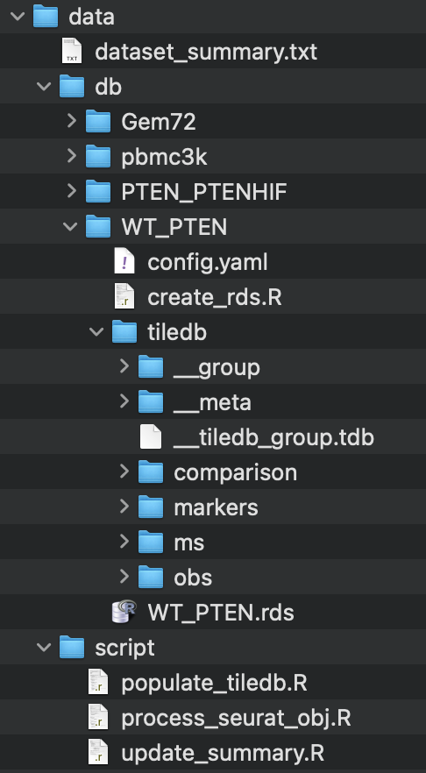
Structure of the database
Text file summarizing basic information about datasets
(~ what is in the “general information” tab, and paths to each dataset objects)
A dataset in the database
Config file (more details later)
Script ran to filter/clean the original Seurat object
Contains differential expression table and aggrexpression
Contains markers table and aggrexpression
Contains individual measurements (~ Seurat’s RNA assay + reductions)
Contains primary annotation (~ Seurat’s metadata)
R object ready-to-download
Useful scripts to manage the database:
add datasets to the database
process a Seurat object to be added to the database
update the dataset_summary.txt file
App data folder

Slide 19

TileDB-SOMA
gene_annotation <- reactive({
var_query <- tiledbsoma::SOMAAxisQuery$new(
value_filter = paste("var_id %in% c(‘”, paste(input$gene_annotation, collapse = "', '", sep = ''))
expt_query <- tiledbsoma::SOMAExperimentAxisQuery$new(
experiment, group, # group = RNA, SCT, integrated…
var_query = var_query
)
expt_query <- expt_query$to_sparse_matrix(
collection = "X",
layer_name = array, # array = scale_data, data, counts…
obs_index = "obs_id",
var_index = "var_id"
)
gene_annotation <- expt_query %>% as.matrix() %>% as.data.frame()
return(gene_annotation)
})
TileDB = engine for storing and accessing dense and sparse multi-dimensional array
SOMA (Stack Of Matrices, Annotated) = specific implementation for single-cell genomic data
Python and R APIs
Doc was not very user friendly… but the package is great as it allows to not load the full object, but only parts of it.
Example of how to retrieve expression of a gene for all cells

Slide 20
Add a dataset to the database
Step 1: Clean your Seurat object
Metadata: convert characters to factors, give clear label names, reorder levels if needed, remove unnecessary metadata
Lighten the object: remove unused assays, remove unnecessary reductions, remove scale.data
Step 2: Create markers and differential expression of interest
Run a script with parameters of interest
Step 3: Add the dataset to the database
Save a R object containing the Seurat object, markers and differential expression (ready-to-download object)
Add a config.yaml for the dataset
Run a script to add this dataset to the database
Update the dataset_summary.txt file
Save all that you did in a R script to be able to reproduce it, and remember the parameters.
title: PTEN HIF vs PTEN
rds: data/db/PTEN_PTENHIF/PTEN_PTENHIF.rds
output_folder: data/db/PTEN_PTENHIF/tiledb
description: 'Hypoxia-mediated stabilization of HIF1A in prostatic intraepithelial neoplasia promotes cell plasticity and malignant progression.'
doi: 10.1126/sciadv.abo2295
date: 22/07/2022
force: true
Example of a config file of a dataset

Slide 21
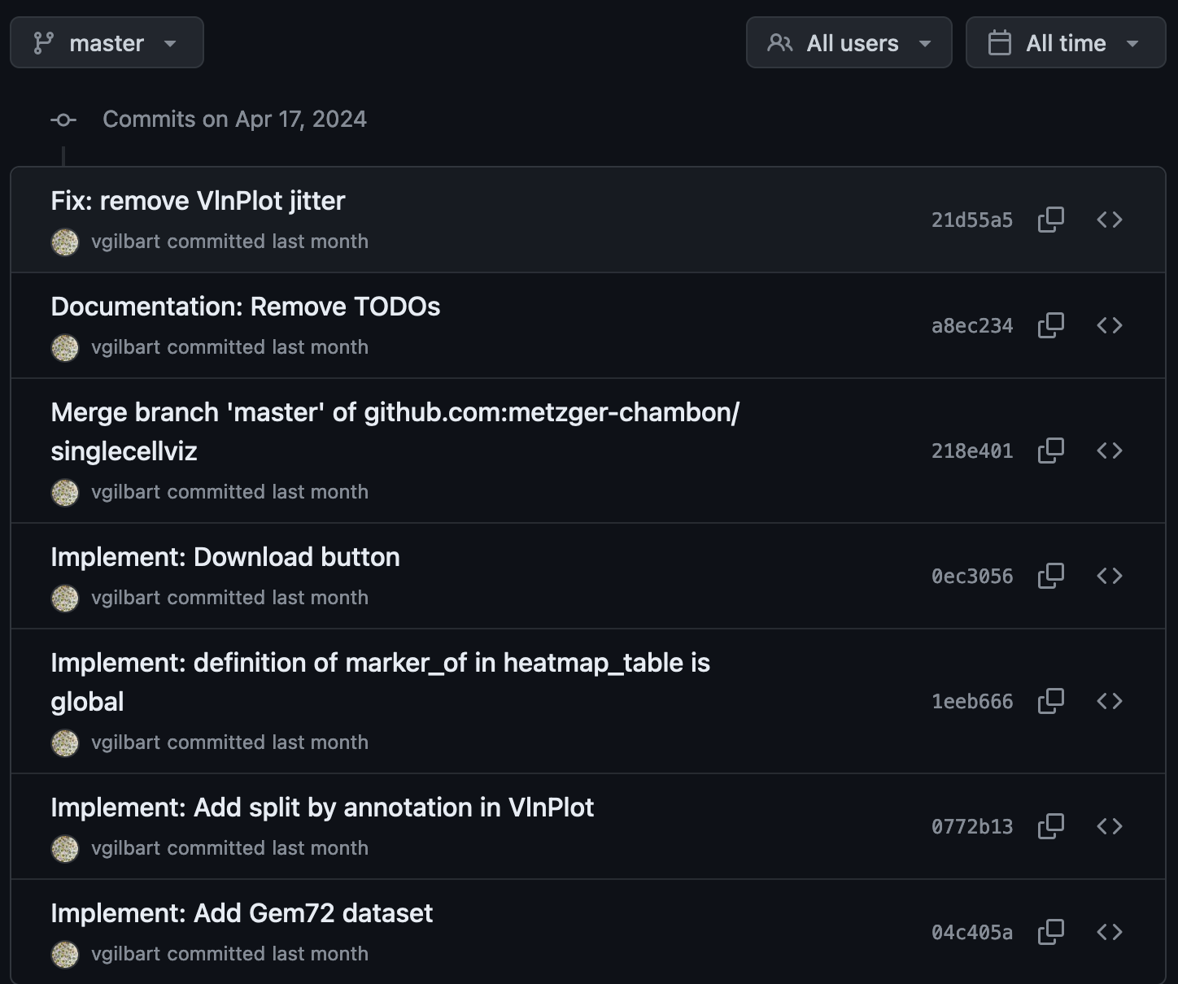


Version control with git
Git = version control system, i.e. track changes made to the code over time
Advantages:
Revert/compare to previous versions
Understand who made changes and why (with commit messages)
Managing conflicts when different changes were made to the code
Github = git platform service to create, store and manage code
Advantages:
Create, assign, and track issues, bugs, and feature requests
Share code to collaborate
App github history

Slide 22

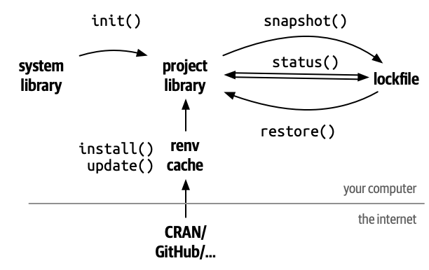
renv
renv package = create reproducible environments for R projects
Project library = each project has its own independent collection of packages at specific versions
App developed locally on my Mac...
But deployed on a Linux server
→ renv eased the download of R packages with the same versions!
Can also be used to:
facilitate collaborations
reproduce your analysis in a couple of years
Work on different projects, with different R packages versions
Limitation: does not deal with R versions
Summary of how to use renv
Notes:
repository (epository is a source of packages, usually somewhere on the Internet) and puts it in a library (a directory on your computer)
https://support.posit.co/hc/en-us/articles/200486138-Changing-R-versions-for-the-RStudio-Desktop-IDE

Slide 23

Unit testing
test_that("clean_result works", {
table_FindMarkers <- # some example data.table
table_FindAllMarkers <- # some other example of data.table
# Rune the functions that we are testing
clean_FindMarkers <- clean_findmarkers_result(table_FindMarkers)
clean_FindAllMarkers <- clean_findmarkers_result(table_FindAllMarkers)
# Check if the returned object is of expected class
expect_s3_class(clean_FindMarkers, "tbl_df")
expect_s3_class(clean_FindAllMarkers, "tbl_df")
# Check that we have the expected table columns
expect_equal(colnames(clean_FindMarkers), c("p_val", "avg_log2FC", "pct.1", "pct.2", "p_val_adj", "gene"))
expect_equal(colnames(clean_FindAllMarkers), c("p_val", "avg_log2FC", "pct.1", "pct.2", "p_val_adj", "cluster", "gene"))
# Check that we have the expected table dimensions
expect_equal(dim(clean_FindMarkers), c(6, 6))
expect_equal(dim(clean_FindAllMarkers), c(6, 7))
})
testthat package = unit testing package for R
Unit testing = systemic method to test isolated snippet of code
How it works?
You create functions to quickly in/validate expected behaviours
When developing, you automatically detect bugs and breaking changes by running existing tests
Why?
Create robust code (for future you, or for collaborations)
Modify functions without testing edge cases manually
Example of a unit testing

Slide 24
Conclusion, limitations and perspectives
CONCLUSION:
Available internally at: https://metzger-chambon.igbmc.science/SingleCellViz/
Quickly download, visualize, explore and highlight results of publicated dataset
LIMITATIONS:
Limited simultaneous users (RAM and CPU)
Limited number of datasets to explore (hard storage)
Not an analysis tool!
PERSPECTIVES:
Write documentation for app and server usage
Deploy externally (after internal beta-testing)
Add (publicated?) datasets

Slide 25
Thank you ☺

Slide 26
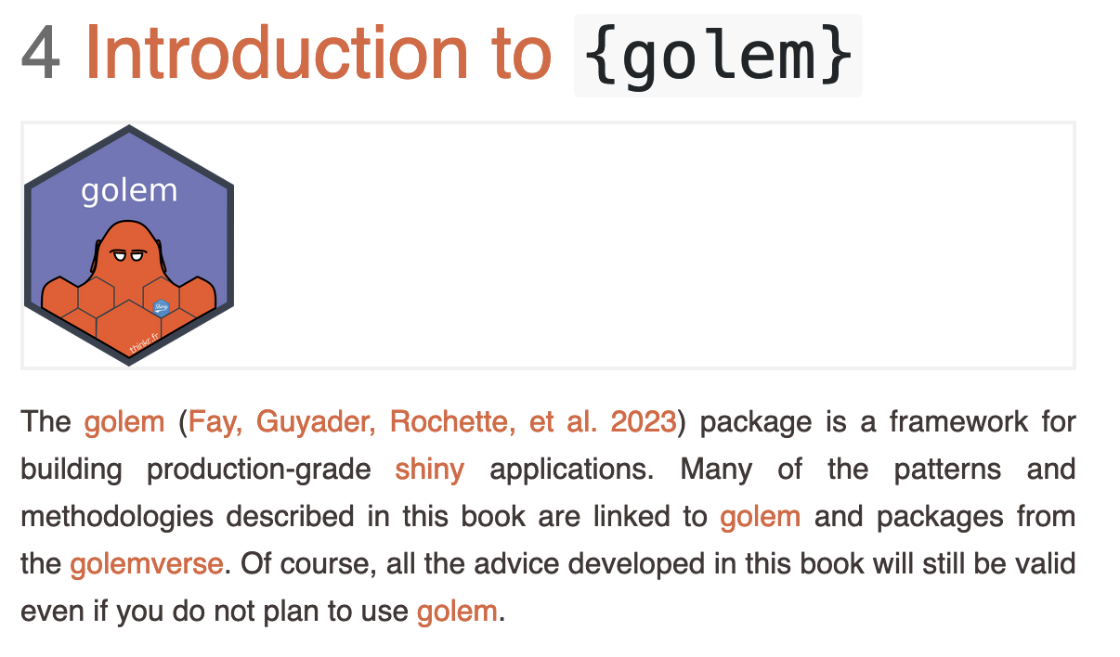
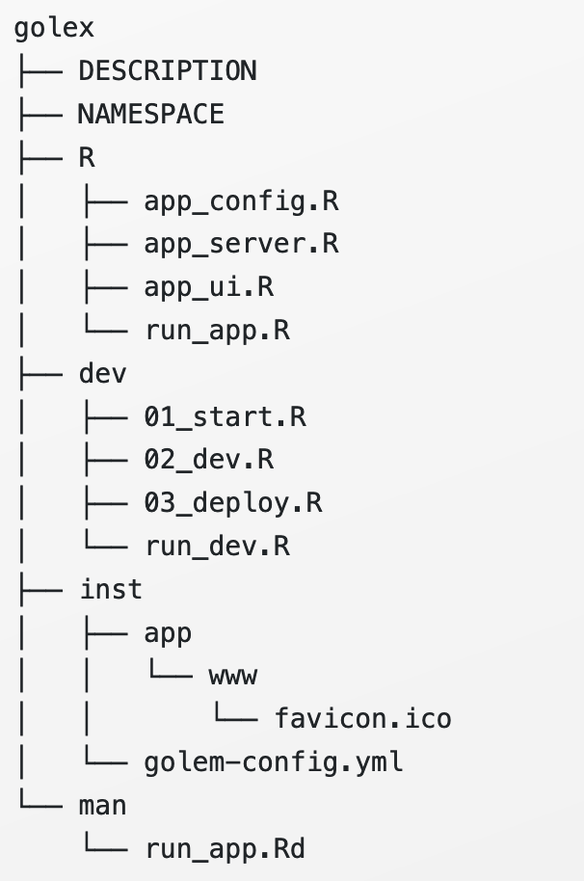
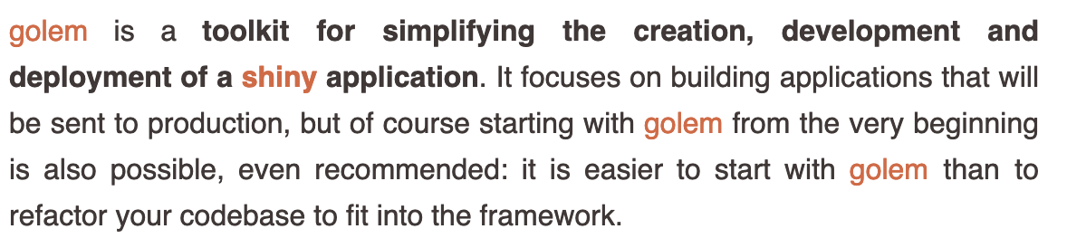
Suppl: golem
https://engineering-shiny.org/
https://thinkr-open.github.io/golem/

Slide 27
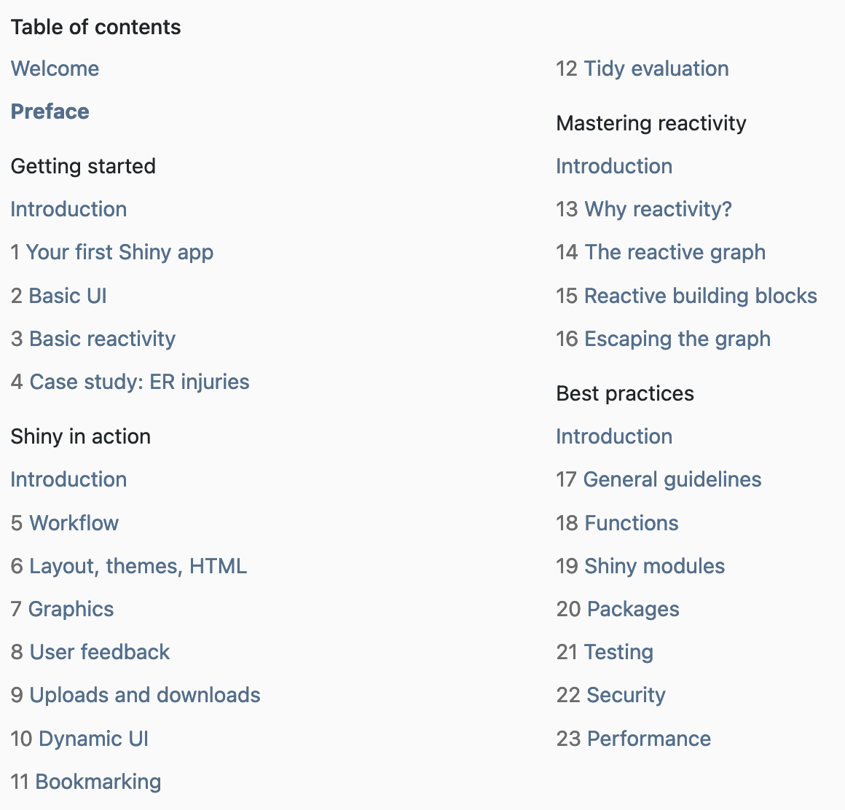
Suppl: Shiny best practices
https://mastering-shiny.org/

Slide 28
Suppl:

